Slide 1

Meet The Teacher Evening
Evenlode

Slide 2
Teacher/TA names
Class teacher:
Mr Webber
Teaching assistants (and all round superstars):
Mrs Hodgson and Miss Green

Slide 3
Differences in this class to previous one
Maths homework is set as normal – termly and self marked then a celebration of it in the last week of each term.
Spelling is done 'ideally' 3 times weekly on Emile.
Reading is recorded on Readathon rather than in reading diaries as this gives us a lot more useful information and the children seem far more motivated with it.
If you prefer the paper reading diaries then please feel free to fill those in as well.
No 99 club or TTRS work set for whole class.
  Individual times table work may be set if extra practice would be useful though.
Standard day in class
Monday
8.50-9.20 | Spelling/Guided reading
9.20-10.20 | Maths
10.20-10.40 | Break
10.40-11.00 | GPS/Handwriting
11.00-12.00 | Writing
12.00-13.00 | Lunch
13.00-13.15 | Mastering Number/Assembly
13.15-14.00 | MFL
14.00-15.00 | Science
15.00-15.10 | Class text

Slide 4


Slide 5


Slide 6
Autumn term:
Anglo-Saxons and Vikings
Spring term:
The Mayans and Mountains
Summer term:
Local Study: Hailes Abbey

Slide 7
Homework Information
Reading:
Please hear your child read every day if possible, but at least three times a week for at least 10 minutes.
Please support them in remembering to fill in their Readathon record.
It is important to read with your child in a quiet place and if possible, take time to talk about the book .

Slide 8
Homework Information
Spelling:
Set on Emile for the term and a parallel list is sent out each term.
  Ideally, your child should practice the spellings 3 times over the week outside of school to help embed the spellings.
There’s a check on words every three weeks as a ‘battle’. This will test the last six spelling patterns that have been taught.

Slide 9

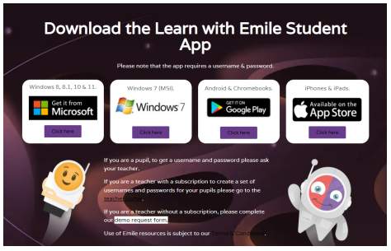
You can download Emile and use it on any Windows, Android, Linux or IOS device. Alternatively, you can access the program through a browser. A link for this will be on our website and on a letter that will be coming out soon.
Spelling homework is set weekly in line with your child's class spellings. Ideally, we are looking at the children practicing at home using Emile for 10-30 minutes throughout the week. Of course there will also be paper copies of all spellings if you prefer your child to not use a screen.

Slide 10
Homework Information
Maths:
Your child will be provided with a booklet of activity sheets at the start of each term and a workbook to record their workings and answers in. There will be one sheet per week which will provide an opportunity to reinforce and practice content covered in lessons.

Slide 11
Forest School/ PE days/schedule
Term 1, 3 and 5
Monday | Tuesday | Wednesday | Thursday | Friday
 | P.E | P.E
Term 2, 4 and 6
Monday | Tuesday | Wednesday | Thursday | Friday
 | P.E | Forest School

Slide 12
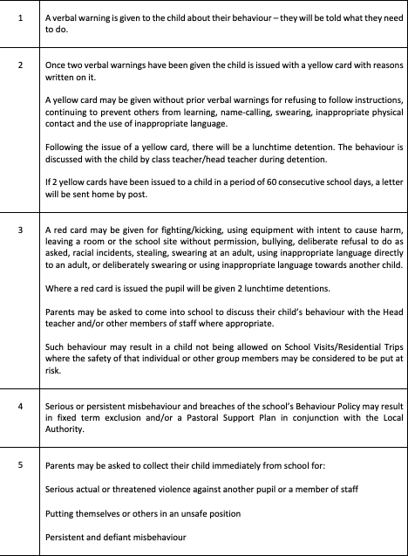
Behaviour Policy

Slide 13
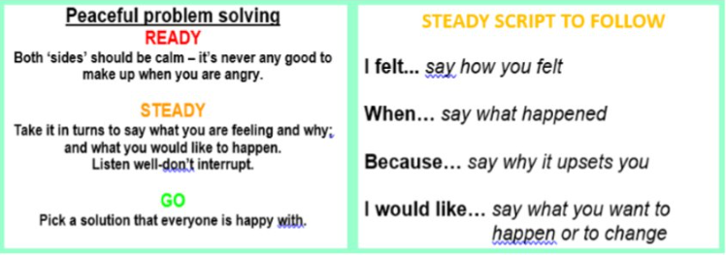
Peaceful Problem Solving

Slide 14
Any Questions?

